Slide 1
Team members:-
M Srikar (24BCE0285)
SRIHARI (24BCI0088)
J GIRISH (24BAI0047)
Introduction
The global transition toward cashless economies, real-time retail payment rails (such as India's Unified Payments Interface [UPI], Immediate Payment Service [IMPS], and the Euro system’s TARGET Instant Payment Settlement [TIPS]), and digital commerce has elevated database management systems from passive data repositories to mission-critical transaction arbiters. In a financial context, an electronic payment is not a mere update to a numeric field; it represents a legally binding, multi-stage state transition between sovereign parties governed by strict accounting standards.
Atomicity: Every fund transfer involves at least two interrelated balance adjustments—a debit from the payer's account and a corresponding credit to the payee's account. If an unexpected power outage, network severance, or hardware fault occurs mid-stream, the database engine must roll back the entire transaction to its pre-initiation state. A partial transfer where funds vanish from the sender without appearing in the receiver's account represents a catastrophic failure.
Payment processing systems operate under unique and uncompromising architectural pressures. Unlike social media or content management applications where eventual consistency is acceptable, financial ledgers must strictly exhibit ACID properties:
Consistency: The database must transition exclusively between valid financial states. Invariants such as non-negative account balances, positive transaction amounts, valid currency alignments, and balanced ledger postings must be maintained across all modifications through declarative schema constraints and programmatic triggers.
DBMS Case Study | Review 1
1

Slide 2
Introduction (cont.)
Isolation: When hundreds or thousands of simultaneous payment requests target the same merchant or consumer account within milliseconds, the database engine must isolate each concurrent execution to prevent race conditions, dirty reads, non-repeatable reads, and lost updates. The database must produce identical final states regardless of the arbitrary interleaving of concurrent execution threads.
Consequently, relying solely on application-level logic to preserve financial integrity introduces severe vulnerabilities. True transactional security requires declarative database constraints, normalized schema topologies, immutable ledger structures, and disciplined reconciliation workflows implemented directly within the RDBMS. This case study demonstrates these foundational database engineering principles using Oracle Database.
Durability: Once a payment is confirmed and acknowledged to the end-user, its persistent state and corresponding double-entry ledger entries must survive any subsequent operating system crash, power loss, or storage failure. In Oracle Database, this is fundamentally guaranteed through Write-Ahead Logging (WAL) via redo log buffers, online redo logs, and checkpointing.
Within modern banking architectures, the database layer serves as the ultimate source of truth. Application servers, microservices, and network gateways are transient and prone to crash-restart cycles.
DBMS Case Study | Review 1
2

Slide 3
1. Problem Statement & Domain Analysis
1.1 Problem Statement
It applies relational constraints, appropriate table relationships, SQL operations, and analytical queries to demonstrate how database management principles support reliable financial recordkeeping.
Modern digital payment systems handle numerous transactions involving customers, bank accounts, and payment gateways. Maintaining accurate and consistent financial records becomes challenging when multiple transactions occur simultaneously, payment requests are repeated because of network timeouts, or transaction processing fails midway. Differences between internal transaction records and external payment-provider reports can also make it difficult to identify missing payments, duplicate records, and incorrect amounts.
1.2 Domain Analysis
The project belongs to the domain of financial transaction processing and payment reconciliation. In this domain, a payment represents a financial operation that must be recorded accurately and associated with the relevant accounts and transaction history.
These situations highlight the need for a well-designed database that maintains data integrity, supports reliable transaction processing, preserves financial records, and identifies discrepancies. A poorly designed database may allow duplicate transaction records, inconsistent account balances, incomplete audit trails, or inaccurate reconciliation results.
The system focuses on five important challenges:
Concurrent Account Updates: Multiple transactions may attempt to modify the same account balance simultaneously. Without suitable transaction control, these operations can produce incorrect balances or lost updates.
This case study addresses these challenges by designing and implementing a relational database using Oracle SQL. The proposed system organizes users, bank accounts, payment transactions, double-entry ledger entries, payment gateways, external transaction records, reconciliation batches, exceptions, and audit logs.
Duplicate Payment Requests: Network timeouts may cause clients to retry a request even when the original payment has already been recorded. Unique idempotency keys help prevent duplicate transaction records.
DBMS Case Study | Review 1
3

Slide 4
1. Problem Statement & Domain Analysis (cont.)
Transaction Failures: A payment may fail during processing, creating a risk of incomplete financial updates. Transaction management and rollback mechanisms are important for maintaining consistency.
The database also includes a double-entry ledger structure, audit records, and simulated external payment-provider data for reconciliation. The initial review focuses on database design and basic SQL implementation, while advanced PL/SQL procedures, triggers, and concurrency-control experiments can be developed in the subsequent review.
Financial Record Consistency: Each successful transfer should have corresponding debit and credit ledger entries of equal value. This double-entry approach provides a way to verify the accounting balance of recorded transactions.
The objective is not to replace existing commercial payment systems, but to demonstrate how fundamental DBMS concepts can be applied and evaluated in a realistic financial scenario.
1.4 Scope of the Case Study
Internal and External Reconciliation: Internal payment records may differ from external gateway records because of missing transactions, duplicate records, amount mismatches, or status differences. Reconciliation queries help identify and classify these discrepancies.
The implementation is limited to a database prototype using simulated payment data. It does not process real money, connect to live banking APIs, or implement a complete commercial payment gateway. Its primary focus is relational database design, data integrity, SQL operations, financial record consistency, and reconciliation analysis.
1.3 Proposed Approach
The case study uses Oracle Database to model the financial domain through a normalized relational schema with primary keys, foreign keys, unique constraints, check constraints, and default values. SQL queries are used to insert, modify, retrieve, validate, and summarize transaction data.
DBMS Case Study | Review 1
4

Slide 5
2. Requirements Analysis
2.1 Functional Requirements
Functional requirements describe the operations and services that the database must support. In this project, the requirements focus on storing user information, managing bank accounts, recording payment transactions, maintaining financial ledger entries, and identifying discrepancies between internal transaction records and external payment gateway records.
The following functional requirements define the expected capabilities of the proposed database system.
Requirement ID | Functional requirement | Description
FR-01 | User Identity Management | Store user details, contact information and KYC verification status. The supported KYC states are PENDING, VERIFIED and REJECTED.
FR-02 | Multi-Account Ownership | Allow a user to maintain multiple bank accounts associated with different banks. Each account must be linked to the appropriate user.
FR-03 | Gateway Routing and Payment Profiles | Store payment gateway configurations, fee structures and user payment profiles, including daily transaction limits, per-transaction limits and two-factor authentication status.
FR-04 | Idempotent Transaction Logging | Record payment requests with unique transaction references and idempotency keys so that duplicate submissions using the same key can be rejected.
FR-05 | Double-Entry Ledger Recording | Maintain debit and credit entries for financial transactions. The ledger design must support the accounting rule that total debit entries equal total credit entries for a finalized payment.
FR-06 | External Settlement Data Management | Store simulated external payment gateway settlement records for comparison with the database's internal transaction records.
FR-07 | Reconciliation and Exception Identification | Compare internal transactions with external settlement records and identify missing records, amount differences and status mismatches.
FR-08 | Audit Trail Management | Maintain audit information for relevant administrative changes, account status changes and transaction state changes.
These functional requirements guide the design of the database tables, relationships, SQL statements and validation rules. The external settlement records in this academic project are simulated; the system does not connect to live banking or payment gateway APIs.
DBMS Case Study | Review 1
5

Slide 6
2.2 Non-Functional Requirements
Non-functional requirements describe the quality, reliability, security and design characteristics expected from the database system. They specify how the database should maintain financial correctness and organize data rather than describing individual user operations.
Requirement ID | Non-functional requirement | Description
NFR-01 | ACID Compliance | Financial operations should follow the principles of atomicity, consistency, isolation and durability. Related database changes must be handled as a transaction to avoid partial updates.
NFR-02 | Audit and Ledger Protection | Ledger entries and security audit records are intended to be append-only, preserving a traceable history instead of allowing ordinary updates or deletions. This protection requires suitable database permissions and implementation controls.
NFR-03 | Duplicate Request Prevention | Unique database constraints on idempotency keys should reject duplicate payment submissions that reuse the same key.
NFR-04 | Normalized Relational Design | The database schema should follow Third Normal Form (3NF) where appropriate to reduce data redundancy and prevent insertion, update and deletion anomalies.
NFR-05 | Security and Data Privacy | Sensitive bank account information should be displayed in a masked form where full details are unnecessary. The document proposes using SQL functions such as SUBSTR for partial masking.
NFR-06 | Oracle Platform Compatibility | Database definitions and SQL scripts should use Oracle-compatible syntax, targeting Oracle Database 12c or later.
These requirements establish the intended design standards for the project. Actual enforcement of properties such as append-only records, transaction isolation and concurrency protection depends on the SQL, permissions and PL/SQL mechanisms implemented and tested.
DBMS Case Study | Review 1
6

Slide 7
2.3 Stakeholders and User Roles
Stakeholders are the individuals or organizations that interact with the payment database or depend on its information. Identifying these roles helps define the data that must be stored and the operations that the database should support.
Stakeholder | Responsibilities
Customer / Payer | Initiates fund transfers, views transaction statuses, manages linked bank accounts and selects payment gateway preferences.
Merchant / Payee | Receives payments, monitors incoming credits and checks payment settlement information.
Payment Gateway Provider | Acts as an external payment intermediary and supplies settlement reports that can be compared with internal transaction records.
Database Administrator (DBA) | Manages the database schema, monitors performance and storage, and reviews audit information.
Compliance and AML Officer | Reviews transaction histories, examines ledger records and investigates potentially suspicious activities.
Financial Reconciliation Analyst | Examines reconciliation results, investigates discrepancies and reviews the records requiring corrective action.
Although these roles represent the intended users of the system, this project concentrates on the database layer. It does not include a separate application interface for each stakeholder.
DBMS Case Study | Review 1
7

Slide 8
2.4 Business Rules
Business rules define the conditions that must be satisfied when financial records are created or modified. They help maintain consistency, prevent invalid data and establish the accounting requirements of the proposed database.
The following rules are derived from the business rules section of the project document.
Rule ID | Business rule | Purpose
BR-01 | Double-entry bookkeeping: For every finalized payment, debit and credit ledger entries must balance, such that total debits equal total credits. | Maintains accounting consistency.
BR-02 | Non-negative account balance: An account balance must not fall below ₹0.00 unless an explicitly supported overdraft arrangement applies. | Prevents invalid negative balances under the project's standard account rules.
BR-03 | Distinct transfer accounts: The sender's account and receiver's account must be different. | Prevents a transfer from being recorded between the same account.
BR-04 | Positive transaction amount: Every payment transaction and ledger entry must have an amount greater than zero. | Rejects zero-value and negative-value entries.
BR-05 | Unique idempotency key: An idempotency key must be unique across the database. | Helps prevent duplicate transaction records when the same request is submitted repeatedly.
BR-06 | Gateway-scoped external reference: An external reference must be unique within its payment gateway, using the combination of gateway ID and external reference ID. | Prevents duplicate external references within the same gateway.
DBMS Case Study | Review 1
8

Slide 9
2.4 Business Rules (cont.)
Rule ID | Business rule | Purpose
BR-07 | Valid transaction status: Transaction statuses must use the permitted values INITIATED, PROCESSING, SUCCESS, FAILED or REVERSED. | Keeps transaction states consistent. Permitted transitions between states require additional logic.
BR-08 | Transaction limits: A transaction must not exceed the user's configured per-transaction limit or applicable daily limit. | Supports payment limit enforcement.
BR-09 | Reconciliation discrepancy classification: Differences between internal transaction records and external settlement records must be classified as AMOUNT_MISMATCH, STATUS_MISMATCH, MISSING_IN_GATEWAY or MISSING_IN_INTERNAL. | Makes discrepancies easier to investigate and report.
BR-10 | Audit tracking: Relevant administrative changes, account status changes and transaction state changes must record the acting database user, timestamp and change details. | Supports traceability and auditing.
DBMS Case Study | Review 1
9

Slide 10
2.4 BUSINESS RULES
How these business rules will be enforced
Different rules require different database mechanisms:
SQL queries: Identify mismatches between internal transactions and external settlement records.
Primary key, foreign key and unique constraints: Enforce identity, relationships and uniqueness.
PL/SQL procedures and triggers: Can enforce more complex transaction workflows, state transitions, audit logging and other rules that cannot be fully expressed using ordinary declarative constraints.
CHECK constraints: Enforce conditions such as positive transaction amounts and non-negative balances.
NOT NULL and DEFAULT constraints: Ensure required information is present and provide default values where specified.
Some rules, particularly balanced double-entry posting, daily transaction limits and append-only ledger protection, require more than a basic column constraint. Their complete enforcement must be demonstrated through suitable implementation and testing.
DBMS Case Study | Review 1
10

Slide 11
3. Entities, Attributes and Keys
3.1 Introduction
In this project, the database is designed to manage users, bank accounts, payment gateways, payment transactions, financial ledger entries, external settlement records, reconciliation batches, exceptions and audit information.
Entities, attributes and keys form the foundation of relational database design. An entity represents an object or concept about which the database stores information. Attributes describe the properties of an entity, while keys uniquely identify records and establish relationships between tables.
The proposed database consists of ten relational tables. Each table represents a specific responsibility, reducing unnecessary data duplication and supporting referential integrity through primary keys and foreign keys.
DBMS Case Study | Review 1
11

Slide 12
3. ENTITIES, ATTRIBUTES AND KEYS
3.2 Entities and Their Attributes
Entity / Table | Important attributes | Primary key | Main foreign key(s)
USERS | Full name, email, phone number, KYC status | user_id | —
BANK_ACCOUNTS | Account number, bank name, balance, account status | account_id | user_id
PAYMENT_GATEWAYS | Gateway name, fee percentage, gateway status | gateway_id | —
PAYMENT_PROFILES | Daily limit, single transaction limit, authentication status | profile_id | user_id, preferred_gateway_id
PAYMENT_TRANSACTIONS | Transaction reference, amount, status, transaction date | transaction_id | sender_account_id, receiver_account_id, gateway_id
LEDGER_ENTRIES | Entry type, amount, entry timestamp | entry_id | transaction_id, account_id
EXTERNAL_TRANSACTIONS | External reference, reported amount, reported status | ext_transaction_id | gateway_id
RECONCILIATION_BATCHES | Batch date, total records, matched records, exception count | batch_id | gateway_id
RECONCILIATION_EXCEPTIONS | Exception type, discrepancy amount, resolution status | exception_id | batch_id, internal_transaction_id, ext_transaction_id
AUDIT_LOGS | Table name, action type, performed by, action timestamp | log_id | account_id, transaction_id
Source: Entities, Attributes and Keys and Relational Schema sections of your Word document.
DBMS Case Study | Review 1
12

Slide 13
3. ENTITIES, ATTRIBUTES AND KEYS
3.3 Important Keys
Primary key (PK): Uniquely identifies each record. For example, user_id identifies a user and transaction_id identifies a payment transaction.
Unique key: Prevents duplicate values in specified columns. For example, idempotency_key in PAYMENT_TRANSACTIONS helps prevent duplicate transaction requests.
Foreign key (FK): Connects related tables. For example, user_id in BANK_ACCOUNTS links a bank account to its owner.
DBMS Case Study | Review 1
13

Slide 14
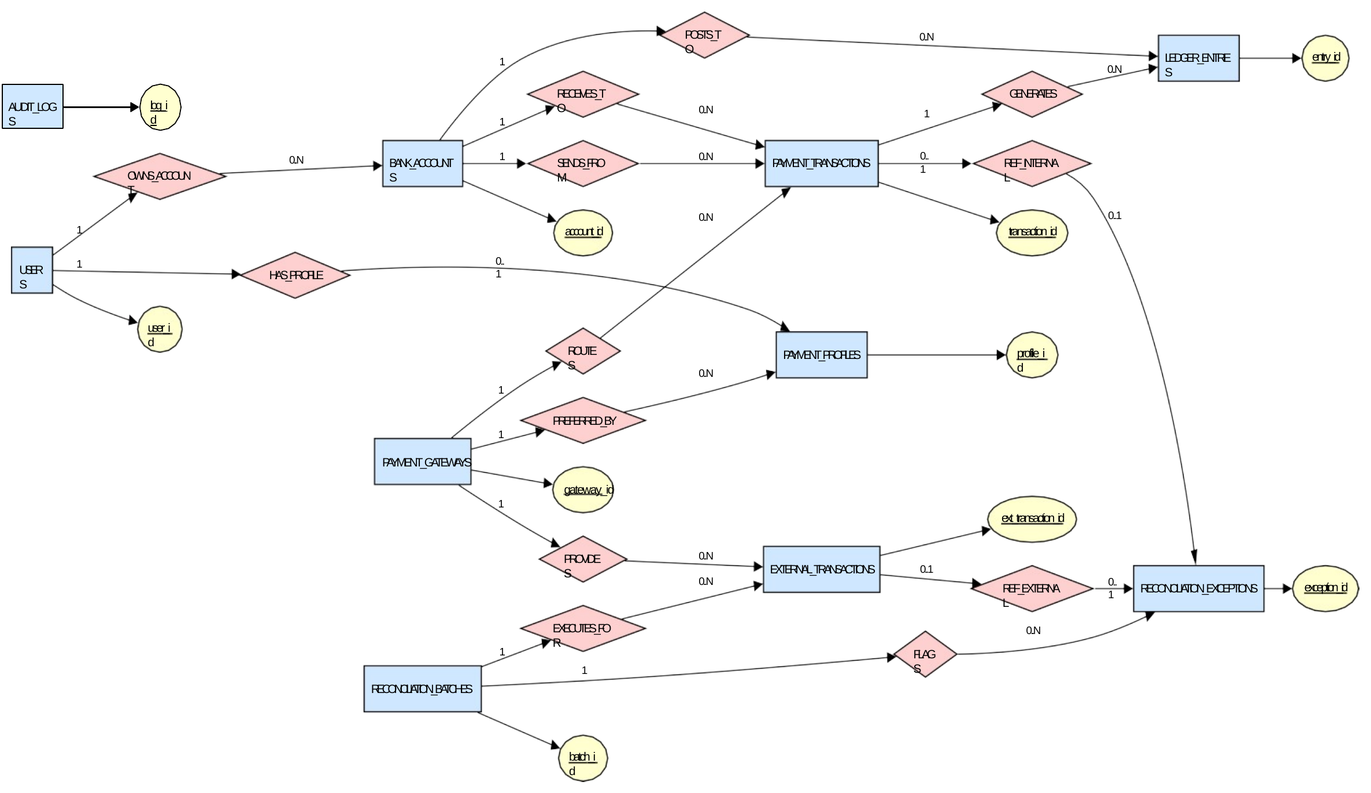
3. ENTITIES, ATTRIBUTES AND KEYS
ER Diagram
DBMS Case Study | Review 1
14

Slide 15
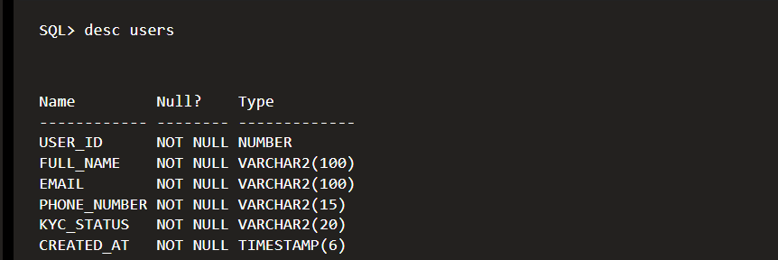
4. DATABASE IMPLEMENTATION — DDL
TABLE 1: USERS
CREATE TABLE USERS (
user_id NUMBER GENERATED BY DEFAULT AS IDENTITY,
full_name VARCHAR2(100) NOT NULL,
email VARCHAR2(100) NOT NULL,
phone_number VARCHAR2(15) NOT NULL,
kyc_status VARCHAR2(20) DEFAULT 'PENDING' NOT NULL,
created_at TIMESTAMP DEFAULT SYSTIMESTAMP NOT NULL,
CONSTRAINT pk_users PRIMARY KEY (user_id),
CONSTRAINT uq_users_email UNIQUE (email),
CONSTRAINT uq_users_phone UNIQUE (phone_number),
CONSTRAINT chk_users_kyc
CHECK (kyc_status IN ('PENDING','VERIFIED','REJECTED'))
);
DBMS Case Study | Review 1
15

Slide 16
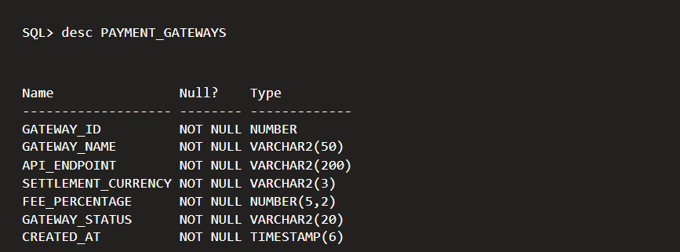
4. DATABASE IMPLEMENTATION — DDL
TABLE 2: PAYMENT_GATEWAYS
CREATE TABLE PAYMENT_GATEWAYS (
gateway_id NUMBER GENERATED BY DEFAULT AS IDENTITY,
gateway_name VARCHAR2(50) NOT NULL,
api_endpoint VARCHAR2(200) NOT NULL,
settlement_currency VARCHAR2(3) DEFAULT 'INR' NOT NULL,
fee_percentage NUMBER(5,2) DEFAULT 1.50 NOT NULL,
gateway_status VARCHAR2(20) DEFAULT 'ACTIVE' NOT NULL,
created_at TIMESTAMP DEFAULT SYSTIMESTAMP NOT NULL,
CONSTRAINT pk_gateways PRIMARY KEY (gateway_id),
CONSTRAINT uq_gateway_name UNIQUE (gateway_name),
CONSTRAINT chk_gateway_fee
CHECK (fee_percentage BETWEEN 0 AND 100),
CONSTRAINT chk_gateway_status
CHECK (gateway_status IN ('ACTIVE','MAINTENANCE','INACTIVE'))
);
DBMS Case Study | Review 1
16

Slide 17
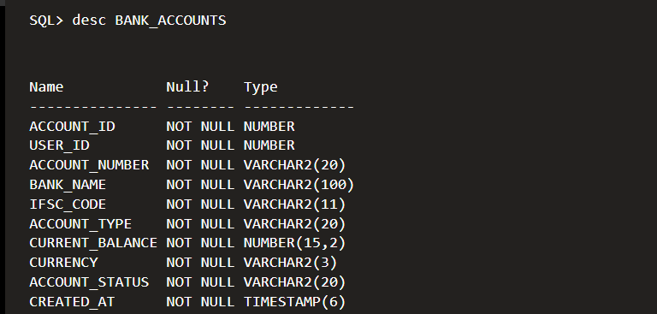
4. DATABASE IMPLEMENTATION — DDL
TABLE 3: BANK_ACCOUNTS
CREATE TABLE BANK_ACCOUNTS (
account_id NUMBER GENERATED BY DEFAULT AS IDENTITY,
user_id NUMBER NOT NULL,
account_number VARCHAR2(20) NOT NULL,
bank_name VARCHAR2(100) NOT NULL,
ifsc_code VARCHAR2(11) NOT NULL,
account_type VARCHAR2(20) DEFAULT 'SAVINGS' NOT NULL,
current_balance NUMBER(15,2) DEFAULT 0 NOT NULL,
currency VARCHAR2(3) DEFAULT 'INR' NOT NULL,
account_status VARCHAR2(20) DEFAULT 'ACTIVE' NOT NULL,
created_at TIMESTAMP DEFAULT SYSTIMESTAMP NOT NULL,
CONSTRAINT pk_bank_accounts PRIMARY KEY (account_id),
CONSTRAINT fk_acc_user FOREIGN KEY (user_id) REFERENCES USERS(user_id),
CONSTRAINT uq_account_number UNIQUE (account_number),
CONSTRAINT chk_account_type
CHECK (account_type IN ('SAVINGS','CURRENT')),
CONSTRAINT chk_account_balance CHECK (current_balance >= 0),
CONSTRAINT chk_account_currency
CHECK (currency IN ('INR','USD','EUR','GBP')),
CONSTRAINT chk_account_status
CHECK (account_status IN ('ACTIVE','FROZEN','CLOSED'))
);
DBMS Case Study | Review 1
17

Slide 18
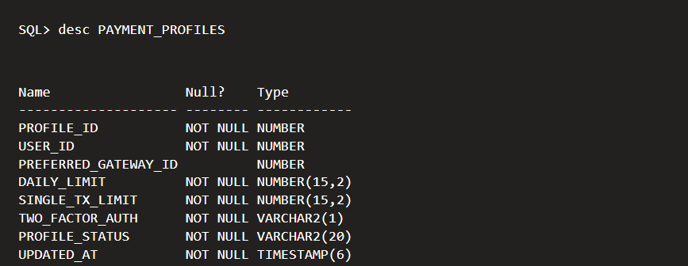
4. DATABASE IMPLEMENTATION — DDL
TABLE 4: PAYMENT_PROFILES
CREATE TABLE PAYMENT_PROFILES (
profile_id NUMBER GENERATED BY DEFAULT AS IDENTITY,
user_id NUMBER NOT NULL,
preferred_gateway_id NUMBER,
daily_limit NUMBER(15,2) DEFAULT 50000 NOT NULL,
single_tx_limit NUMBER(15,2) DEFAULT 10000 NOT NULL,
two_factor_auth VARCHAR2(1) DEFAULT 'Y' NOT NULL,
profile_status VARCHAR2(20) DEFAULT 'ACTIVE' NOT NULL,
updated_at TIMESTAMP DEFAULT SYSTIMESTAMP NOT NULL,
CONSTRAINT pk_profiles PRIMARY KEY (profile_id),
CONSTRAINT fk_profile_user FOREIGN KEY (user_id)
REFERENCES USERS(user_id),
CONSTRAINT uq_profile_user UNIQUE (user_id),
CONSTRAINT fk_profile_gateway FOREIGN KEY (preferred_gateway_id)
REFERENCES PAYMENT_GATEWAYS(gateway_id),
CONSTRAINT chk_daily_limit CHECK (daily_limit >= 0),
CONSTRAINT chk_single_limit CHECK (single_tx_limit >= 0),
CONSTRAINT chk_two_factor CHECK (two_factor_auth IN ('Y','N')),
CONSTRAINT chk_profile_status
CHECK (profile_status IN ('ACTIVE','SUSPENDED'))
);
DBMS Case Study | Review 1
18

Slide 19
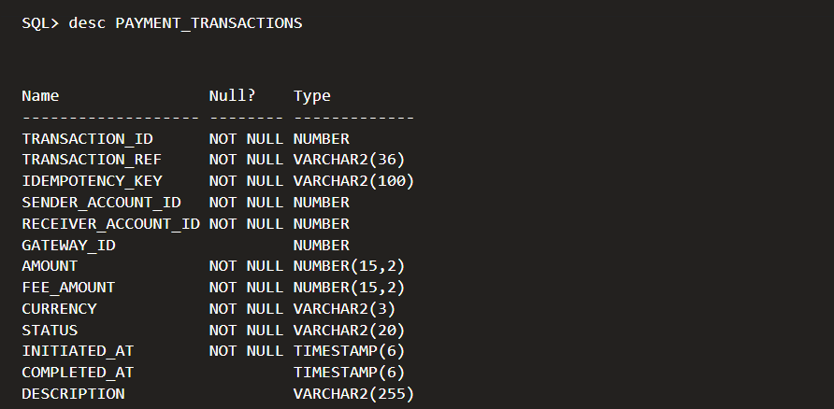
4. DATABASE IMPLEMENTATION — DDL
TABLE 5: PAYMENT_TRANSACTIONS
CREATE TABLE PAYMENT_TRANSACTIONS (
transaction_id NUMBER GENERATED BY DEFAULT AS IDENTITY,
transaction_ref VARCHAR2(36) NOT NULL,
idempotency_key VARCHAR2(100) NOT NULL,
sender_account_id NUMBER NOT NULL,
receiver_account_id NUMBER NOT NULL,
gateway_id NUMBER,
amount NUMBER(15,2) NOT NULL,
fee_amount NUMBER(15,2) DEFAULT 0 NOT NULL,
currency VARCHAR2(3) DEFAULT 'INR' NOT NULL,
status VARCHAR2(20) DEFAULT 'INITIATED' NOT NULL,
initiated_at TIMESTAMP DEFAULT SYSTIMESTAMP NOT NULL,
completed_at TIMESTAMP,
description VARCHAR2(255),
CONSTRAINT pk_transactions PRIMARY KEY (transaction_id),
CONSTRAINT uq_transaction_ref UNIQUE (transaction_ref),
CONSTRAINT uq_idempotency_key UNIQUE (idempotency_key),
CONSTRAINT fk_txn_sender FOREIGN KEY (sender_account_id)
REFERENCES BANK_ACCOUNTS(account_id),
CONSTRAINT fk_txn_receiver FOREIGN KEY (receiver_account_id) REFERENCES BANK_ACCOUNTS(account_id),
CONSTRAINT fk_txn_gateway FOREIGN KEY (gateway_id)
REFERENCES PAYMENT_GATEWAYS(gateway_id),
CONSTRAINT chk_txn_amount CHECK (amount > 0),
CONSTRAINT chk_txn_fee CHECK (fee_amount >= 0),
CONSTRAINT chk_txn_status
CHECK (status IN ('INITIATED','PROCESSING','SUCCESS','FAILED','REVERSED')),
CONSTRAINT chk_different_accounts
CHECK (sender_account_id <> receiver_account_id)
);
DBMS Case Study | Review 1
19

Slide 20
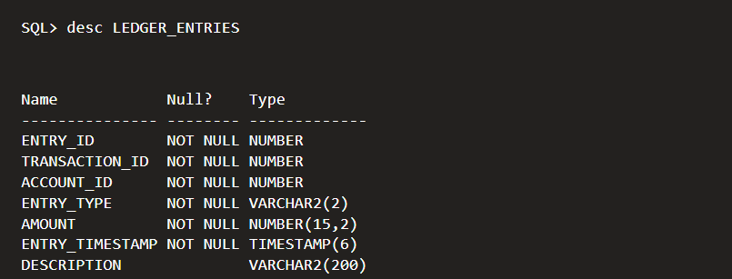
4. DATABASE IMPLEMENTATION — DDL
TABLE 6: LEDGER_ENTRIES
CREATE TABLE LEDGER_ENTRIES (
entry_id NUMBER GENERATED BY DEFAULT AS IDENTITY,
transaction_id NUMBER NOT NULL,
account_id NUMBER NOT NULL,
entry_type VARCHAR2(2) NOT NULL,
amount NUMBER(15,2) NOT NULL,
entry_timestamp TIMESTAMP DEFAULT SYSTIMESTAMP NOT NULL,
description VARCHAR2(200),
CONSTRAINT pk_ledger PRIMARY KEY (entry_id),
CONSTRAINT fk_ledger_txn FOREIGN KEY (transaction_id) REFERENCES PAYMENT_TRANSACTIONS(transaction_id),
CONSTRAINT fk_ledger_account FOREIGN KEY (account_id) REFERENCES BANK_ACCOUNTS(account_id),
CONSTRAINT chk_entry_type CHECK (entry_type IN ('DR','CR')),
CONSTRAINT chk_ledger_amount CHECK (amount > 0)
);
DBMS Case Study | Review 1
20

Slide 21
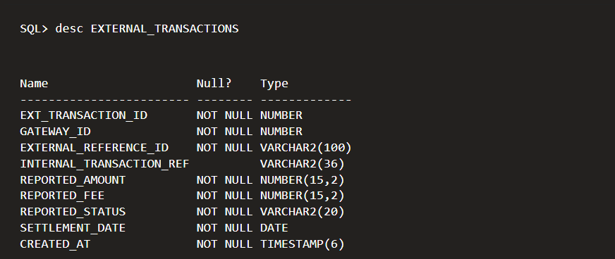
4. DATABASE IMPLEMENTATION — DDL
TABLE 7: EXTERNAL_TRANSACTIONS
CREATE TABLE EXTERNAL_TRANSACTIONS (
ext_transaction_id NUMBER GENERATED BY DEFAULT AS IDENTITY,
gateway_id NUMBER NOT NULL,
external_reference_id VARCHAR2(100) NOT NULL,
internal_transaction_ref VARCHAR2(36),
reported_amount NUMBER(15,2) NOT NULL,
reported_fee NUMBER(15,2) DEFAULT 0 NOT NULL,
reported_status VARCHAR2(20) NOT NULL,
settlement_date DATE NOT NULL,
created_at TIMESTAMP DEFAULT SYSTIMESTAMP NOT NULL,
CONSTRAINT pk_external_txns PRIMARY KEY (ext_transaction_id),
CONSTRAINT fk_external_gateway FOREIGN KEY (gateway_id)
REFERENCES PAYMENT_GATEWAYS(gateway_id),
CONSTRAINT uq_gateway_external_ref
UNIQUE (gateway_id, external_reference_id),
CONSTRAINT chk_reported_amount CHECK (reported_amount > 0),
CONSTRAINT chk_reported_fee CHECK (reported_fee >= 0),
CONSTRAINT chk_reported_status
CHECK (reported_status IN ('SUCCESS','FAILURE','PENDING','REFUNDED'))
);
DBMS Case Study | Review 1
21

Slide 22
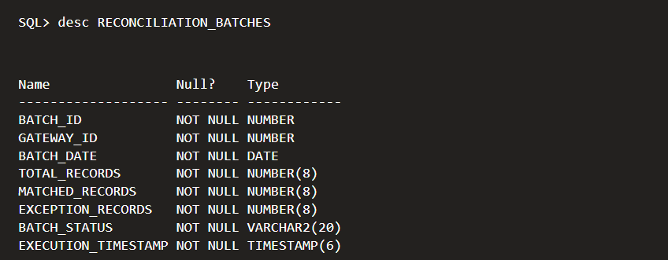
4. DATABASE IMPLEMENTATION — DDL
TABLE 8: RECONCILIATION_BATCHES
CREATE TABLE RECONCILIATION_BATCHES (
batch_id NUMBER GENERATED BY DEFAULT AS IDENTITY,
gateway_id NUMBER NOT NULL,
batch_date DATE NOT NULL,
total_records NUMBER(8) DEFAULT 0 NOT NULL,
matched_records NUMBER(8) DEFAULT 0 NOT NULL,
exception_records NUMBER(8) DEFAULT 0 NOT NULL,
batch_status VARCHAR2(20) DEFAULT 'OPEN' NOT NULL,
execution_timestamp TIMESTAMP DEFAULT SYSTIMESTAMP NOT NULL,
CONSTRAINT pk_recon_batches PRIMARY KEY (batch_id),
CONSTRAINT fk_batch_gateway FOREIGN KEY (gateway_id) REFERENCES PAYMENT_GATEWAYS(gateway_id),
CONSTRAINT chk_batch_total CHECK (total_records >= 0),
CONSTRAINT chk_batch_matched CHECK (matched_records >= 0),
CONSTRAINT chk_batch_exceptions CHECK (exception_records >= 0),
CONSTRAINT chk_batch_status
CHECK (batch_status IN ('OPEN','PROCESSING','COMPLETED','FAILED'))
);
DBMS Case Study | Review 1
22

Slide 23
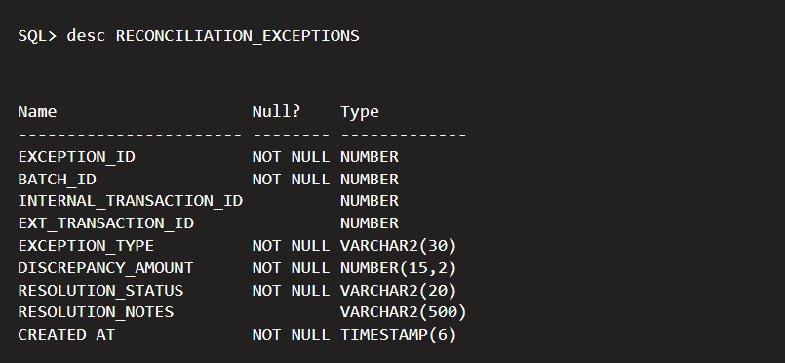
4. DATABASE IMPLEMENTATION — DDL
TABLE 9: RECONCILIATION_EXCEPTIONS
CREATE TABLE RECONCILIATION_EXCEPTIONS (
exception_id NUMBER GENERATED BY DEFAULT AS IDENTITY,
batch_id NUMBER NOT NULL,
internal_transaction_id NUMBER,
ext_transaction_id NUMBER,
exception_type VARCHAR2(30) NOT NULL,
discrepancy_amount NUMBER(15,2) DEFAULT 0 NOT NULL,
resolution_status VARCHAR2(20) DEFAULT 'UNRESOLVED' NOT NULL,
resolution_notes VARCHAR2(500),
created_at TIMESTAMP DEFAULT SYSTIMESTAMP NOT NULL,
CONSTRAINT pk_recon_exceptions PRIMARY KEY (exception_id),
CONSTRAINT fk_exception_batch FOREIGN KEY (batch_id)
REFERENCES RECONCILIATION_BATCHES(batch_id),
CONSTRAINT fk_exception_internal FOREIGN KEY (internal_transaction_id)
REFERENCES PAYMENT_TRANSACTIONS(transaction_id),
CONSTRAINT fk_exception_external FOREIGN KEY (ext_transaction_id) REFERENCES EXTERNAL_TRANSACTIONS(ext_transaction_id),
CONSTRAINT chk_exception_type CHECK (exception_type IN
('AMOUNT_MISMATCH','STATUS_MISMATCH',
'MISSING_IN_GATEWAY','MISSING_IN_INTERNAL')),
CONSTRAINT chk_resolution_status CHECK (resolution_status IN
('UNRESOLVED','MANUALLY_RESOLVED','AUTO_RESOLVED','WRITTEN_OFF'))
);
DBMS Case Study | Review 1
23

Slide 24
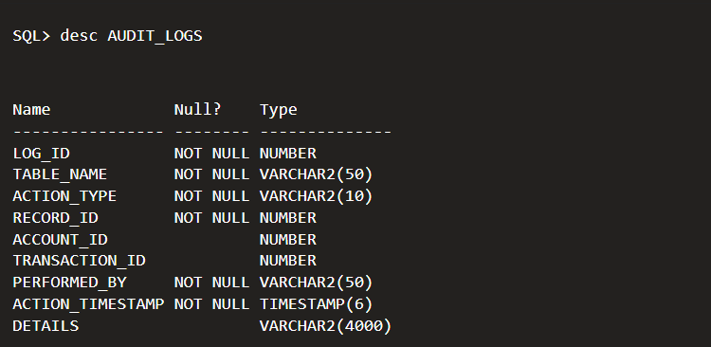
4. DATABASE IMPLEMENTATION — DDL
TABLE 10: AUDIT_LOGS
CREATE TABLE AUDIT_LOGS (
log_id NUMBER GENERATED BY DEFAULT AS IDENTITY,
table_name VARCHAR2(50) NOT NULL,
action_type VARCHAR2(10) NOT NULL,
record_id NUMBER NOT NULL,
account_id NUMBER,
transaction_id NUMBER,
performed_by VARCHAR2(50) DEFAULT USER NOT NULL,
action_timestamp TIMESTAMP DEFAULT SYSTIMESTAMP NOT NULL,
details VARCHAR2(4000),
CONSTRAINT pk_audit_logs PRIMARY KEY (log_id),
CONSTRAINT chk_audit_action
CHECK (action_type IN ('INSERT','UPDATE','DELETE','SECURITY')),
CONSTRAINT fk_audit_account FOREIGN KEY (account_id) REFERENCES BANK_ACCOUNTS(account_id),
CONSTRAINT fk_audit_transaction FOREIGN KEY (transaction_id) REFERENCES PAYMENT_TRANSACTIONS(transaction_id)
);
DBMS Case Study | Review 1
24

Slide 25
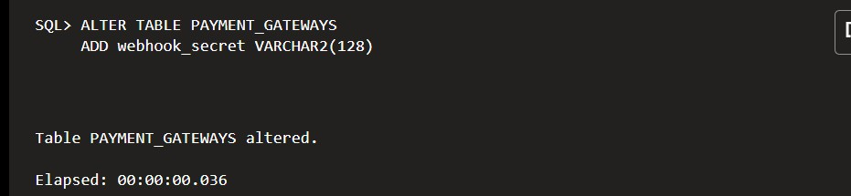
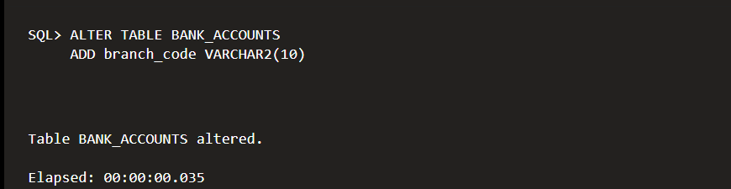
4. DATABASE IMPLEMENTATION — DDL
Altering tables: gateway security field and branch code
Adding a gateway security field and a branch code.
ALTER TABLE PAYMENT_GATEWAYS
ADD webhook_secret VARCHAR2(128);
ALTER TABLE BANK_ACCOUNTS
ADD branch_code VARCHAR2(10);
SELECT table_name, column_name, data_type
FROM user_tab_columns
WHERE table_name = 'USERS' ORDER BY column_id;
DBMS Case Study | Review 1
25

Slide 26
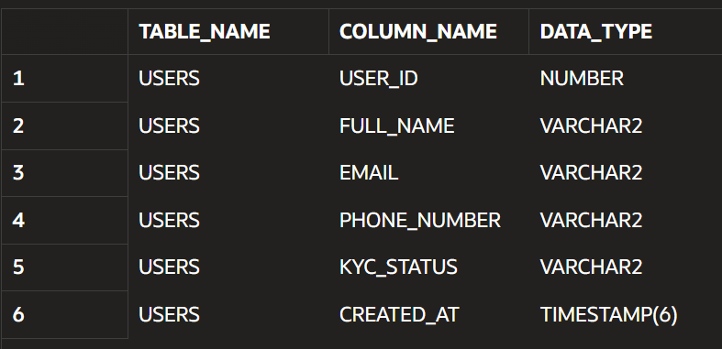
4. DATABASE IMPLEMENTATION — DDL
Altering tables: gateway security field and branch code (cont.)
DBMS Case Study | Review 1
26

Slide 27
4. DATABASE IMPLEMENTATION — DDL
DROP TABLE — Removing a temporary table
Objective: To demonstrate the DROP DDL command without deleting any of the project’s main tables.
Expected result: Table DROP_DEMO_TEMP created, followed by Table DROP_DEMO_TEMP dropped.
CREATE TABLE DROP_DEMO_TEMP (demo_id NUMBER PRIMARY KEY, demo_note VARCHAR2(50)); DROP TABLE DROP_DEMO_TEMP;
Note: Run this example only in the practice schema. It creates and removes a separate temporary demonstration table.
DBMS Case Study | Review 1
27

Slide 28
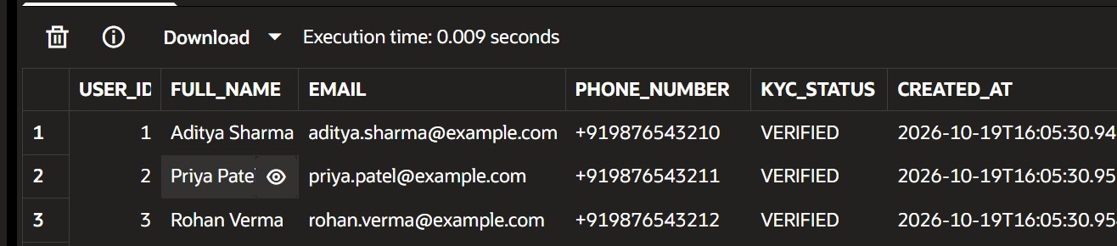
5. DML OPERATIONS (INSERT, UPDATE, DELETE)
1. INSERT — Adding records
Objective: To insert sample user records into the USERS table.
INSERT INTO USERS
(full_name, email, phone_number, kyc_status) VALUES
('Aditya Sharma', 'aditya.sharma@example.com', '+919876543210', 'VERIFIED');
INSERT INTO USERS
(full_name, email, phone_number, kyc_status) VALUES
('Priya Patel', 'priya.patel@example.com', '+919876543211', 'VERIFIED');
INSERT INTO USERS
(full_name, email, phone_number, kyc_status) VALUES
('Rohan Verma', 'rohan.verma@example.com', '+919876543212', 'PENDING');
COMMIT;
DBMS Case Study | Review 1
28

Slide 29
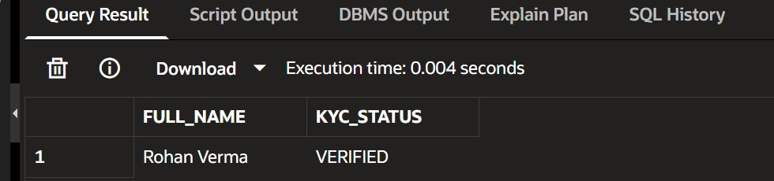
5. DML OPERATIONS (INSERT, UPDATE, DELETE)
3. UPDATE — Modifying existing records
Objective: To update the KYC status of a user.
UPDATE USERS
SET kyc_status = 'VERIFIED'
WHERE email = 'rohan.verma@example.com';
SELECT full_name, kyc_status FROM USERS
WHERE email = 'rohan.verma@example.com';
COMMIT;
Explanation: The UPDATE command changes Rohan Verma's KYC status from PENDING to VERIFIED. The WHERE clause ensures that only the intended user's record is modified. The SELECT statement verifies the change, and COMMIT saves it.
DBMS Case Study | Review 1
29

Slide 30
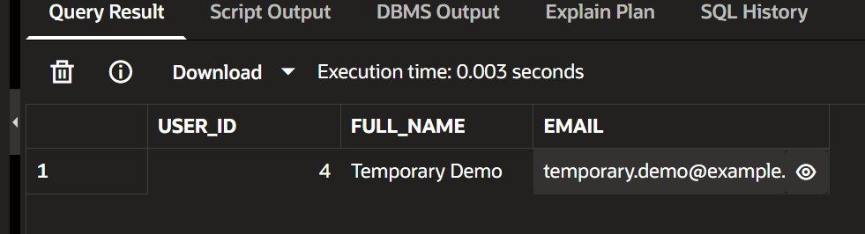
5. DML OPERATIONS (INSERT, UPDATE, DELETE)
4. DELETE — Removing a record
Objective: To demonstrate the deletion of a temporary user record safely.
INSERT INTO USERS
(full_name, email, phone_number, kyc_status) VALUES
('Temporary Demo', 'temporary.demo@example.com',
'+919876543299', 'PENDING');
COMMIT;
SELECT user_id, full_name, email FROM USERS
WHERE email = 'temporary.demo@example.com';
DELETE FROM USERS
WHERE email = 'temporary.demo@example.com';
SELECT user_id, full_name, email FROM USERS
WHERE email = 'temporary.demo@example.com';
COMMIT;
Explanation: The DELETE command removes the temporary user record identified by its unique email address. The first SELECT verifies that the record exists, while the second checks that it has been removed. This user must not have dependent bank-account or payment-profile records.
DBMS Case Study | Review 1
30

Slide 31
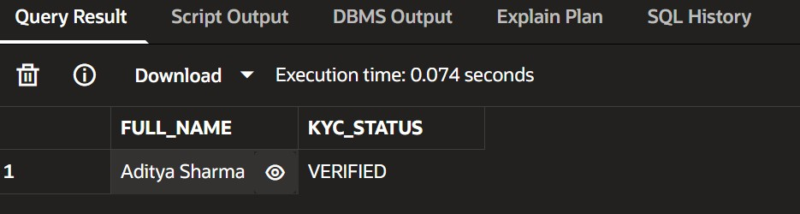
5. DML OPERATIONS (INSERT, UPDATE, DELETE)
5. ROLLBACK — Undoing uncommitted changes
Objective: To demonstrate how an uncommitted database modification can be cancelled.
UPDATE USERS
SET kyc_status = 'PENDING'
WHERE email = 'aditya.sharma@example.com'; ROLLBACK;
SELECT full_name, kyc_status
FROM USERS
WHERE email = 'aditya.sharma@example.com';
DBMS Case Study | Review 1
31

Slide 32
5. DML OPERATIONS (INSERT, UPDATE, DELETE)
7. Constraint validation summary
Constraint | Expected result
Primary key | Duplicate ID rejected
Foreign key | Nonexistent user reference rejected
Unique | Duplicate email rejected
Not null | Missing email rejected
Check | Invalid KYC status rejected
Default | KYC status automatically set to PENDING
SQL*Plus-style output screenshots are included below as illustrative examples. Because the live Oracle database was not available in this editing step, run the queries in your own schema and replace these sample captures with genuine terminal screenshots before submission.
DBMS Case Study | Review 1
32

Slide 33
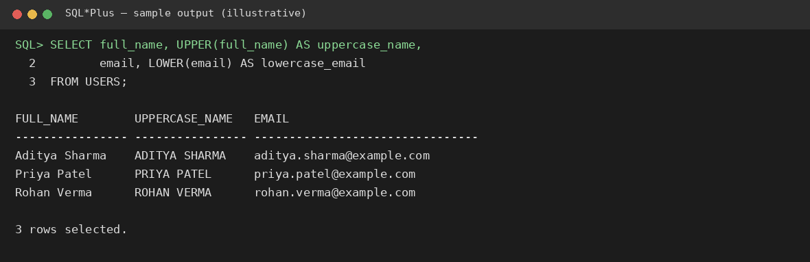
6. Single-Row SQL Functions
Single-row functions operate on one row at a time and return one result for each row. In your payment database, they can help format customer details, mask account numbers, calculate fees and display dates.
UPPER and LOWER
Objective: To standardize names and email addresses for display and lookup.
SELECT
full_name,
UPPER(full_name) AS uppercase_name, email,
LOWER(email) AS lowercase_email FROM USERS;
DBMS Case Study | Review 1
33

Slide 34
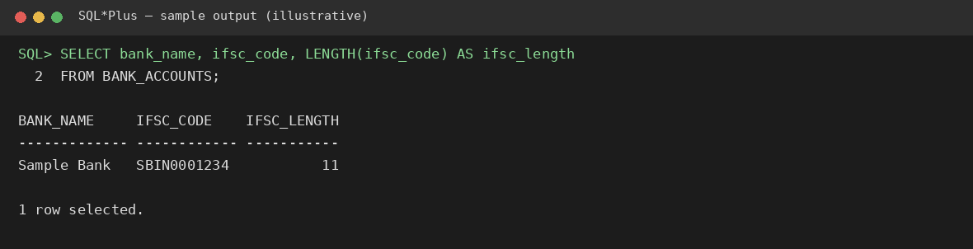
6. SINGLE-ROW SQL FUNCTIONS
2. LENGTH
Objective: To find the number of characters in an IFSC code and phone number.
LENGTH
SELECT
b.bank_name, b.ifsc_code,
LENGTH(b.ifsc_code) AS ifsc_length, u.phone_number,
LENGTH(u.phone_number) AS phone_length FROM BANK_ACCOUNTS b
JOIN USERS u ON b.user_id = u.user_id;
DBMS Case Study | Review 1
34

Slide 35
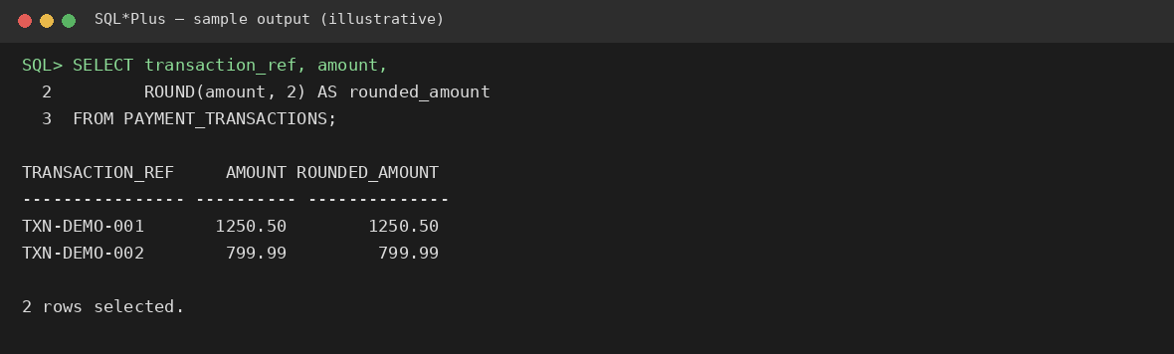
6. SINGLE-ROW SQL FUNCTIONS
2. Numeric Function – ROUND()
Purpose: Round transaction amounts to two decimal places.
ROUND
SELECT transaction_ref,
amount,
ROUND(amount, 2) AS rounded_amount FROM PAYMENT_TRANSACTIONS;
Explanation: ROUND() rounds a numeric value to the specified number of decimal places.
DBMS Case Study | Review 1
35

Slide 36
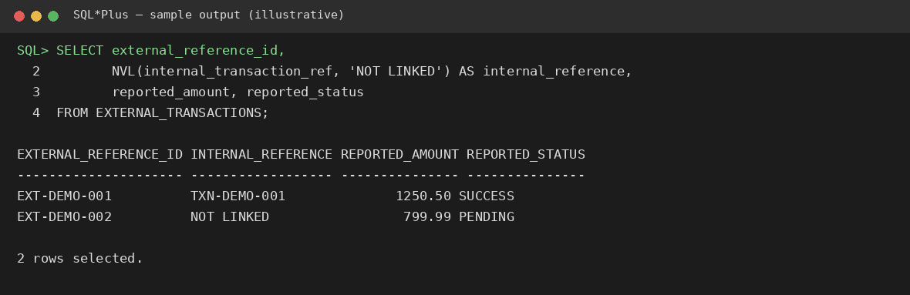
6. SINGLE-ROW SQL FUNCTIONS
2. NVL
Objective: To replace a NULL value with a meaningful message.
SELECT
external_reference_id,
NVL(internal_transaction_ref, 'NOT LINKED') AS internal_reference,
reported_amount,
reported_status
FROM EXTERNAL_TRANSACTIONS;
DBMS Case Study | Review 1
36

Slide 37
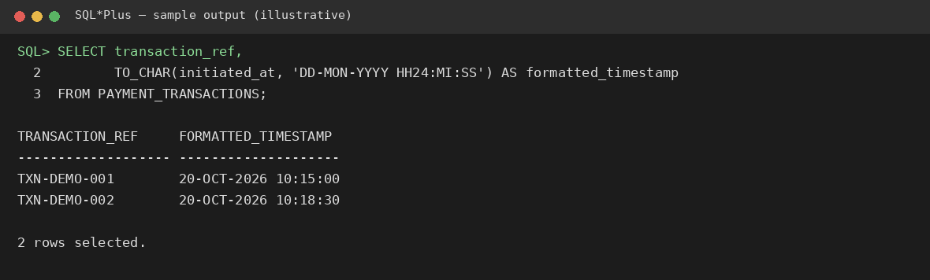
6. SINGLE-ROW SQL FUNCTIONS
3. TO_CHAR
Objective: To display transaction timestamps in a readable format.
SELECT
transaction_ref, TO_CHAR(
initiated_at,
'DD-MON-YYYY HH24:MI:SS'
) AS formatted_timestamp
FROM PAYMENT_TRANSACTIONS;
DBMS Case Study | Review 1
37

Slide 38
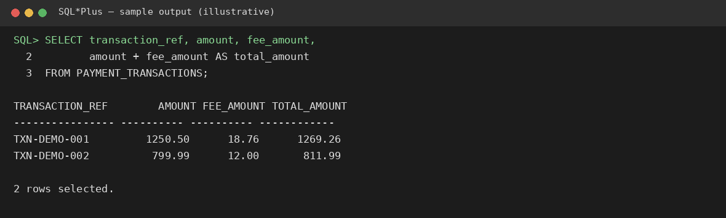
7. SQL Operators and Group Functions
Objective
Sample SQL*Plus output — Arithmetic operator
To demonstrate SQL operators for filtering and calculating payment transaction data, and group functions for summarizing transactions and ledger entries.
SQL Operators
SQL operators help perform calculations, compare values, combine conditions, and filter records.
Arithmetic operator
Purpose: Calculate the total transaction amount, including the transaction fee.
SELECT transaction_ref, amount, fee_amount, amount + fee_amount AS total_amount FROM PAYMENT_TRANSACTIONS;
Explanation: The + operator calculates the transaction amount plus its fee.
DBMS Case Study | Review 1
38

Slide 39
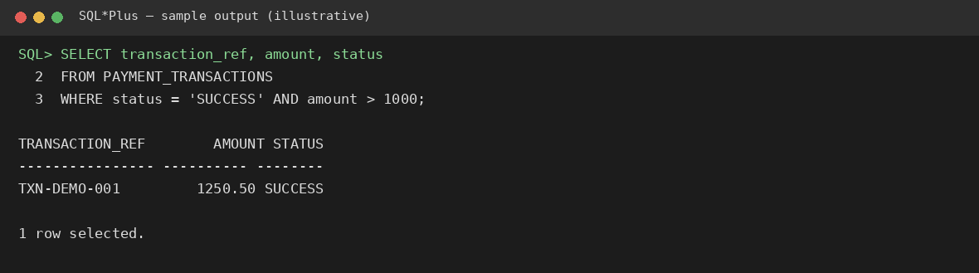
7. SQL OPERATORS AND GROUP FUNCTIONS
B. Comparison and logical operators
Purpose: Filter successful transactions above a specified amount.
Comparison and logical operators
SELECT transaction_ref, amount, status FROM PAYMENT_TRANSACTIONS
WHERE status = 'SUCCESS' AND amount > 1000;
Explanation: = compares values, > compares the amount, and AND requires both conditions to be true.
DBMS Case Study | Review 1
39

Slide 40
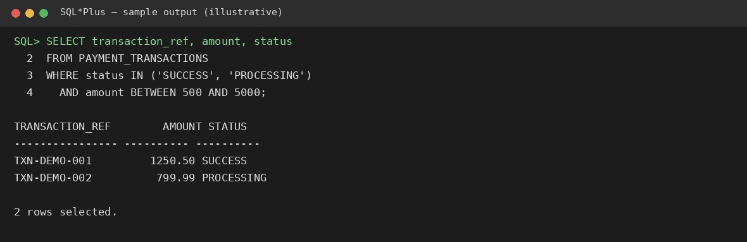
7. SQL OPERATORS AND GROUP FUNCTIONS
C. IN and BETWEEN operators
Purpose: Find transactions in selected states and within an amount range.
IN and BETWEEN
SELECT transaction_ref, amount, status FROM PAYMENT_TRANSACTIONS
WHERE status IN ('SUCCESS', 'PROCESSING') AND amount BETWEEN 500 AND 5000;
Explanation: IN checks membership in a list; BETWEEN includes both range endpoints.
DBMS Case Study | Review 1
40

Slide 41
7. SQL OPERATORS AND GROUP FUNCTIONS
Group Functions (Aggregate Functions)
Group functions calculate one summary value from multiple rows. The following queries use the payment transaction data.
SUM() — Total transaction value
COUNT() — Count transactions
SELECT SUM(amount) AS total_transaction_amount FROM PAYMENT_TRANSACTIONS;
SELECT COUNT(*) AS transaction_count FROM PAYMENT_TRANSACTIONS;
AVG() — Average transaction value
SELECT AVG(amount) AS average_transaction_amount FROM PAYMENT_TRANSACTIONS;
DBMS Case Study | Review 1
41

Slide 42
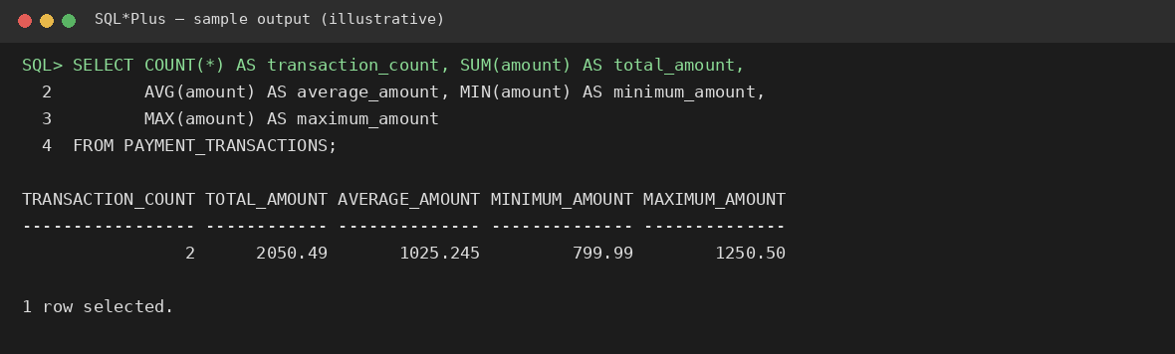
7. SQL OPERATORS AND GROUP FUNCTIONS
D. MIN() and MAX() — Smallest and largest transaction
SELECT MIN(amount) AS minimum_amount, MAX(amount) AS maximum_amount
FROM PAYMENT_TRANSACTIONS;
COUNT, SUM, AVG, MIN and MAX
DBMS Case Study | Review 1
42

Slide 43
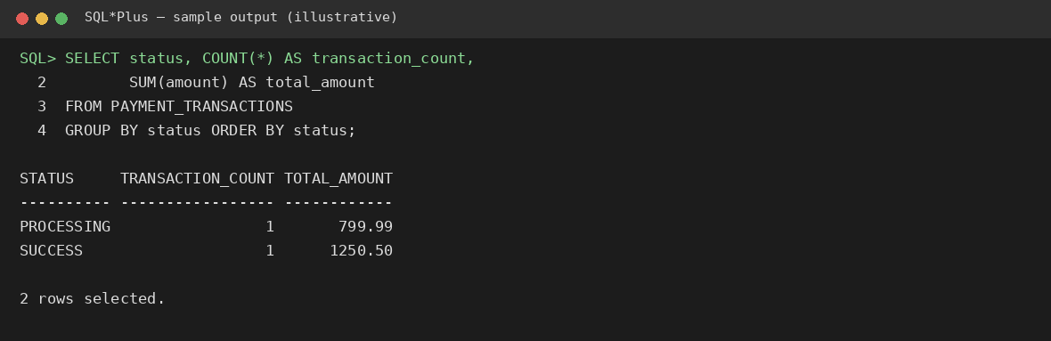
7. SQL OPERATORS AND GROUP FUNCTIONS
E. GROUP BY — Summarize transactions by status
SELECT status, COUNT(*) AS transaction_count, SUM(amount) AS total_amount FROM PAYMENT_TRANSACTIONS
GROUP BY status ORDER BY status;
GROUP BY
DBMS Case Study | Review 1
43

Slide 44
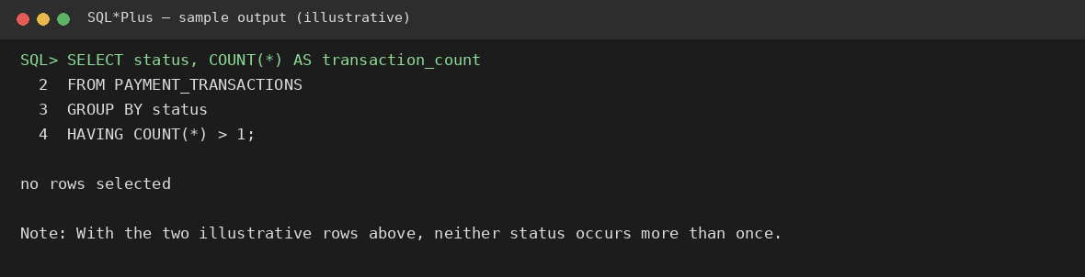
7. SQL OPERATORS AND GROUP FUNCTIONS
F. HAVING — Filter grouped results
SELECT status, COUNT(*) AS transaction_count FROM PAYMENT_TRANSACTIONS
GROUP BY status HAVING COUNT(*) > 1;
HAVING
DBMS Case Study | Review 1
44

Slide 45
Conclusion
This case study successfully demonstrates the design and implementation of a relational database for a digital payment processing and reconciliation system using Oracle SQL. It covers the fundamental stages of database development, including problem and domain analysis, requirement identification, stakeholder analysis, business rules, entity identification, attribute specification, key definition, and ER diagram design. The database implementation demonstrates DDL commands such as CREATE, ALTER, and DROP, along with integrity constraints including PRIMARY KEY, FOREIGN KEY, UNIQUE, NOT NULL, CHECK, and DEFAULT to maintain data accuracy and consistency. DML commands such as INSERT, UPDATE, and DELETE are used to manage database records effectively.
Furthermore, single- row functions, SQL operators, and group functions are applied to format data, perform calculations, filter transactions, and generate meaningful summaries.
Through this review, the importance of proper database design, referential integrity, and efficient SQL query processing in financial applications is established. The proposed database structure provides a foundation for managing payment transactions, maintaining consistent records, and supporting transaction analysis and reconciliation. Overall, Review 1 has strengthened the understanding of relational database concepts and their practical implementation using Oracle SQL, providing a strong foundation for the subsequent stages of the case study and the study of advanced SQL and PL/SQL concepts.
Case study PDF link :- https://drive.google.com/file/d/19kPQCNkfiCL0IXipucwChaBhBWcAPozM/view?usp=sharing
DBMS Case Study | Review 1
45

